Slide 1

COVID - 19
A CASE-STUDY
Notes:
The outbreak of Covid-19 has developed into a major international crisis and is impacting important aspects of daily life with emergencies and lockdowns across countries worldwide.
This case study aims to bring data from various sources to provide a deeper understanding of the pandemic and the impact it has globally.

Slide 2
CONTENTS
1
4
Introduction
Social Media Interactions
2
5
The Journey
Forecast (cases)
3
6
Recommendations & Next Steps
Research & Insights
Notes:
These is the agenda for my presentation today

Slide 3
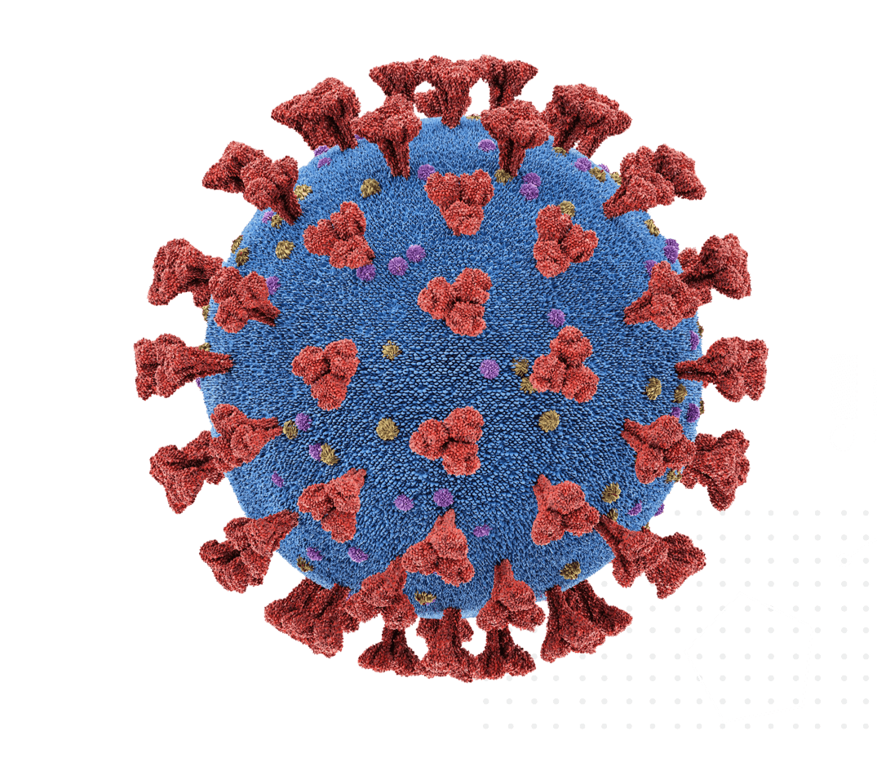
COVID-19 THROUGH DATA LENS
INSIGHTS
Gain better understanding of the pandemic - trends, demographics
FUTURE
Forecasting new cases for the near future
RESEARCH
Bring together multiple data sources
SOCIAL PULSE
See how communities lift themselves up in crisis
IMPACT
Monitor impact in the areas of global health, government responses & economy
Notes:
Here goes an overview of my case study that can be translated to the problem statement as well.
Analysing the current covid-19 situation through a data lens
Insights : gain better understanding of the pandemic by looking at case trends, demographics affected, mortality rates etc.
Housing additional sources of data within here to help with one shot view.
Impact : Monitor impact of the pandemic in the areas of global health, government responses and global economy
Understand the pulse of the public by tracing social media interactions from twitter to make meaningful interpretations of how people behave and react to this global crisis.
Lastly, a close look at the immediate future by forecasting

Slide 4
THE JOURNEY
01
02
03
RESEARCH & INSIGHTS
SOCIAL INTERACTIONS
FORECASTING
CURRENT SITUATION
SOCIAL INDICATORS
CONFIRMED & FATAL CASES
Global Health Indicators
Demographic Indicators
Government Response Indicators
Economic Indicators
Understanding social media interactions through topic modeling of tweets relating to Covid-19
Forecast for 19-25 April through predictive modeling.
Viz tool
Tableau
Models
Latent Dirichlet Allocation Non-Negative Matrix Factorization
Model
RNN-LSTM
Notes:
The mentioned scope was achieved through this journey.
The first step being gathering data from several sources to be housed together on top of the base dataset that is available from JHU.
The aim was to assess the current situation with the 4 indicators hosted within Tableau vis. tool
2nd step was to tap of social media interactions to understand how people expressed themselves in such a crisis through topic modeling of tweets relating to covid-19. Models used were SK learns’s LDA and NMF
The final step was to perform a prediction of the number of confirmed and fatal cases for the period 19-25 Apr and to assess the accuracy of this forecast to evaluate the model. The model used was LSTM which is a form of RNN
LDA is based on probabilistic graphical modeling while NMF relies on linear algebra.
A tf-idf transformer is applied to the bag of words matrix that NMF must process with the TfidfVectorizer. LDA on the other hand, being a probabilistic graphical model (i.e. dealing with probabilities) only requires raw counts, so a CountVectorizer is used.

Slide 5
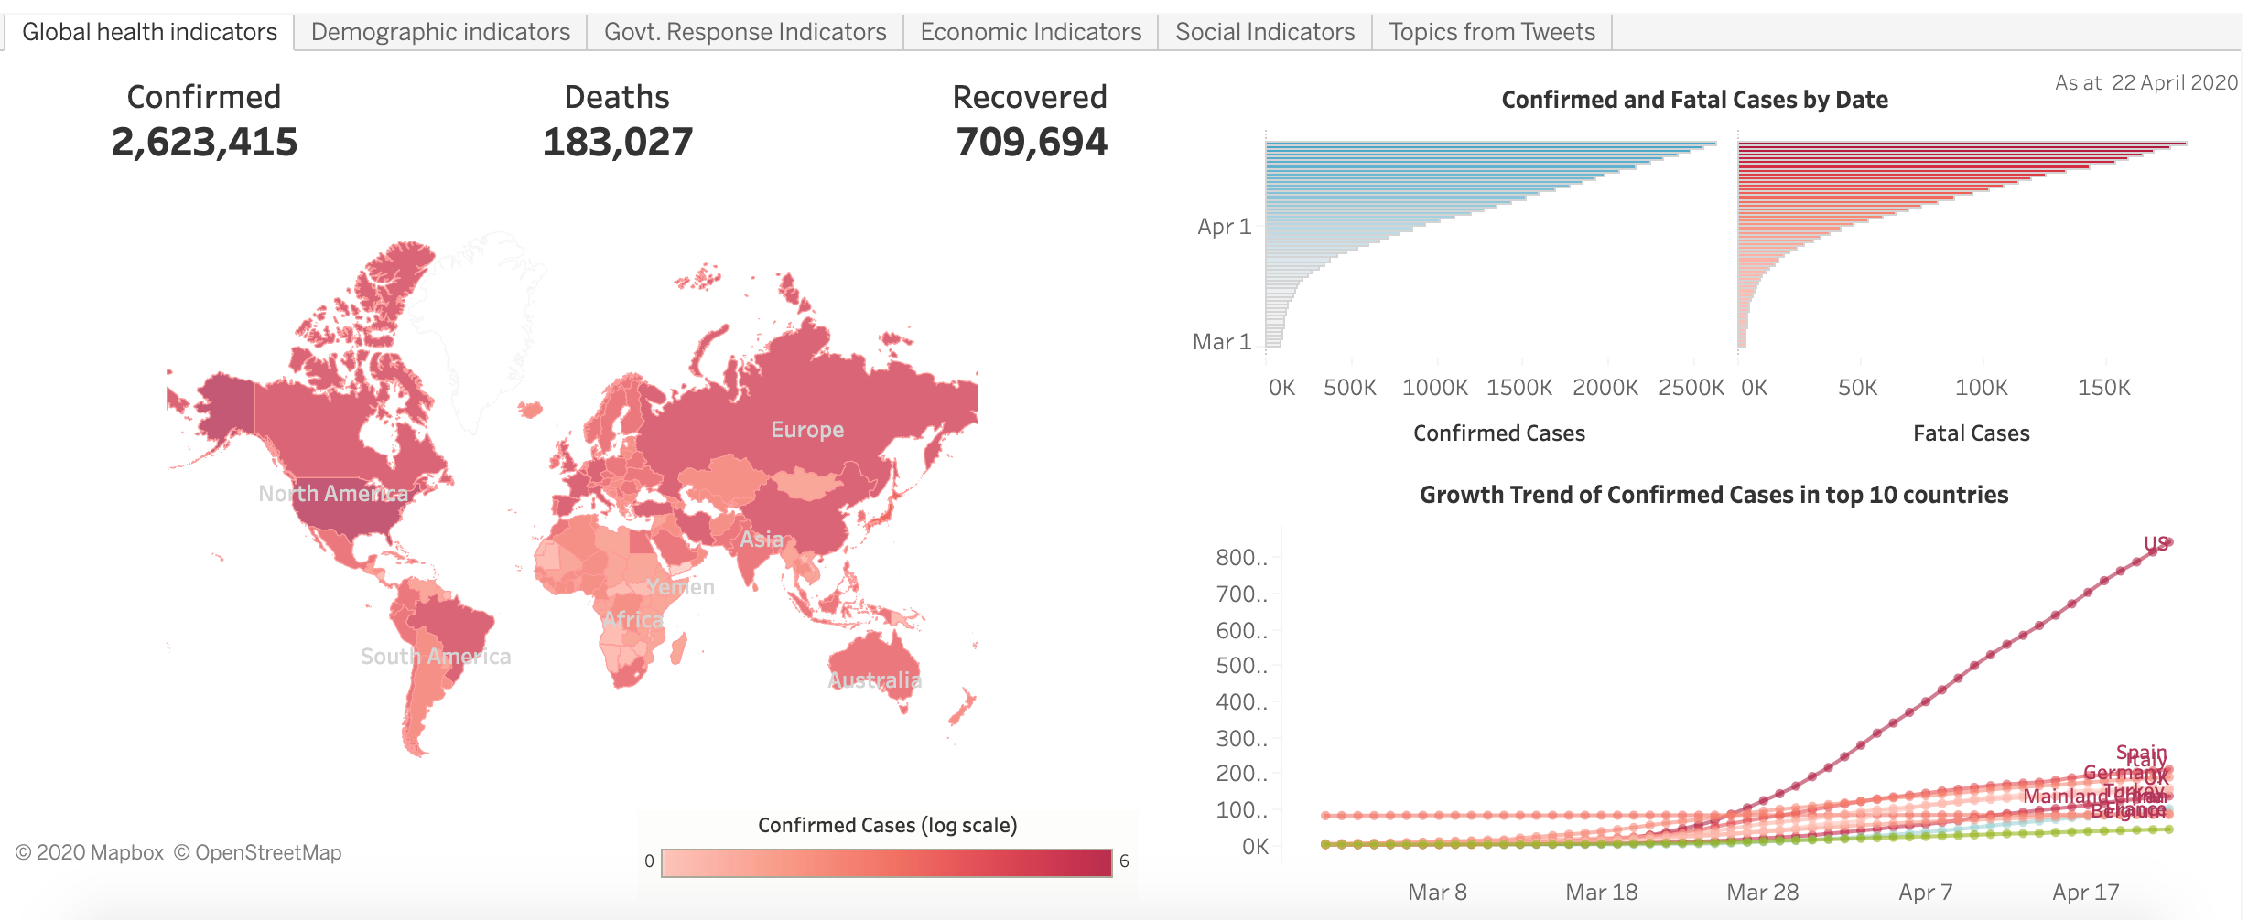
RESEARCH & INSIGHTS
https://public.tableau.com/profile/akhila.joseph#!/vizhome/CovidDashboard2_15860650422580/Globalhealthindicators?publish=yes
Notes:
understand how people are impacted and reacting to this global crisis
Global Health Indicators - a look at the trend of daily case numbers and countries affected the most
Demographic Indicators - a look into cases by age range for highly affected countries
Government Response Indicators - association analysis of stringency measures implemented vs. increasing case numbers
: Looking at association analysis between stringency index (a derivative of stringency measures taken by governments in response to covid-19 situation), most of the countries with exponential growth has managed to curb the growth and stabilize the number of newly confirmed cases with higher stringency measures. United States is an exception in this case. The country raised its overall stringency index only to 76 thus far and the confirmed cases have been growing. This does suggest a direct correlation between stringency measures and the growth of new cases in the countries.
Economic Indicators - exploring the trend of daily closing prices for key global stock indices

Slide 6
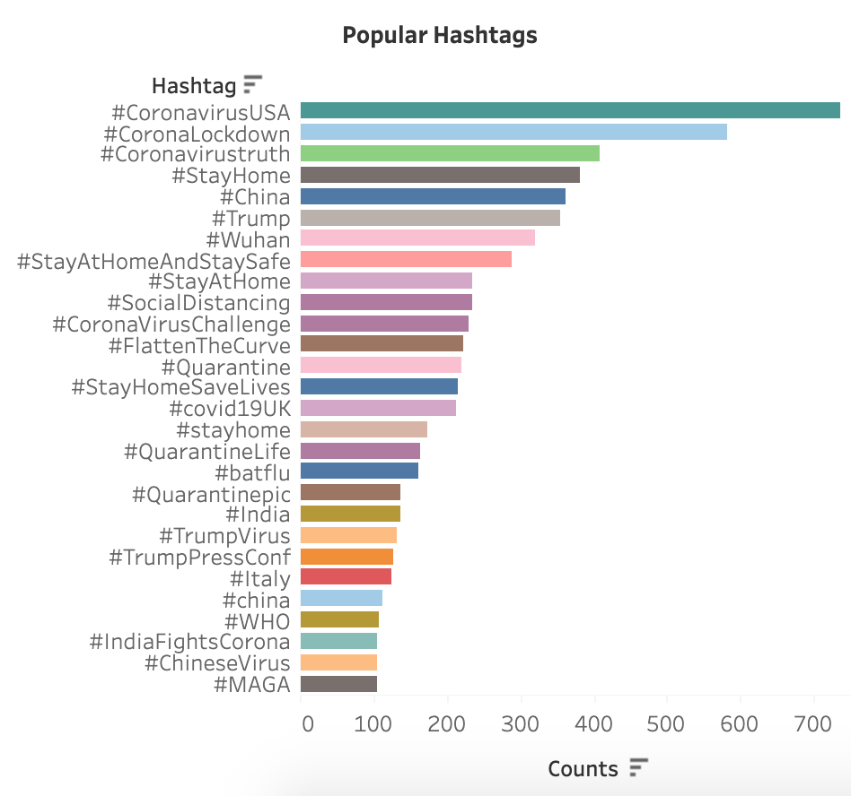
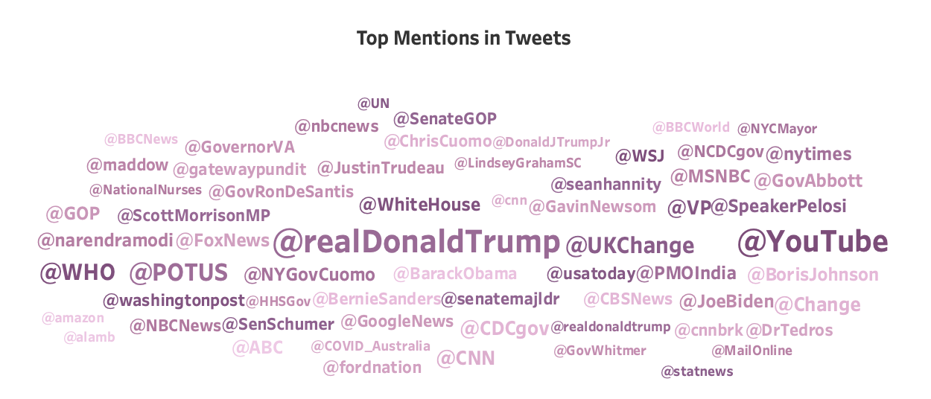
SOCIAL PULSE - TWEETS EDA

Slide 7

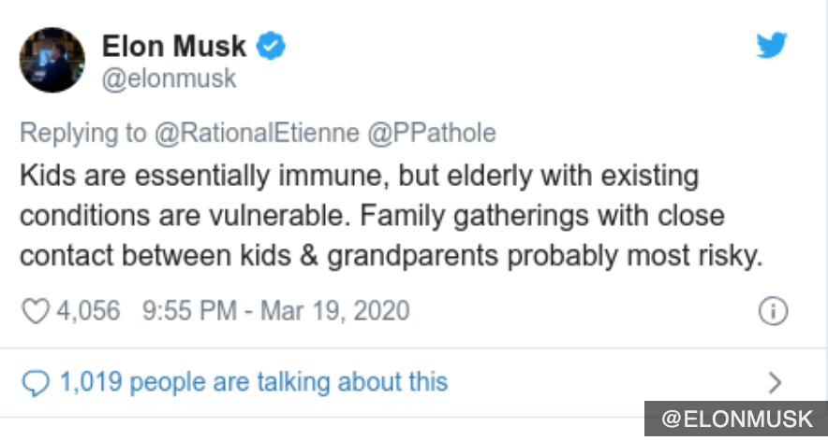
SOCIAL PULSE - TOPIC MODELING
56,000 tweets
Remove patterns
- retweets and mentions
Remove links
(http | https
Remove punctuations, numbers & special characters
Remove stop words
Tokenize & Lemmatize
change to lower case
Normalized corpus
Count - vectorizer
LDA
Evaluate & Visualize
TF-IDF
NMF
Evaluate & Visualize
http://localhost:8888/view/Documents/DS/Projects/Akhila-Joseph-Projects/Project_5/Covid-19/code/lda.html
Notes:
LDA is based on probabilistic graphical modeling while NMF relies on linear algebra.
A tf-idf transformer is applied to the bag of words matrix that NMF must process with the TfidfVectorizer. LDA on the other hand, being a probabilistic graphical model (i.e. dealing with probabilities) only requires raw counts, so a CountVectorizer is used.
LDA Vis
Very big probability mass function over all of the possible words in the model for each individual topic
Area of the topic : relative prevalence of the topic in the corpus
Distance between the topics is an approximation of the semantic relationship between the 2 topics (e.g. topic 1- cure and 3- research)
Red bars - frequency of each word given a topic
Relevance or lamda - can be adjusted to down to put more weight on words frequencies within topic vs. overall word frequency (reg to grey bar ratio) or simply put term relevance

Slide 8
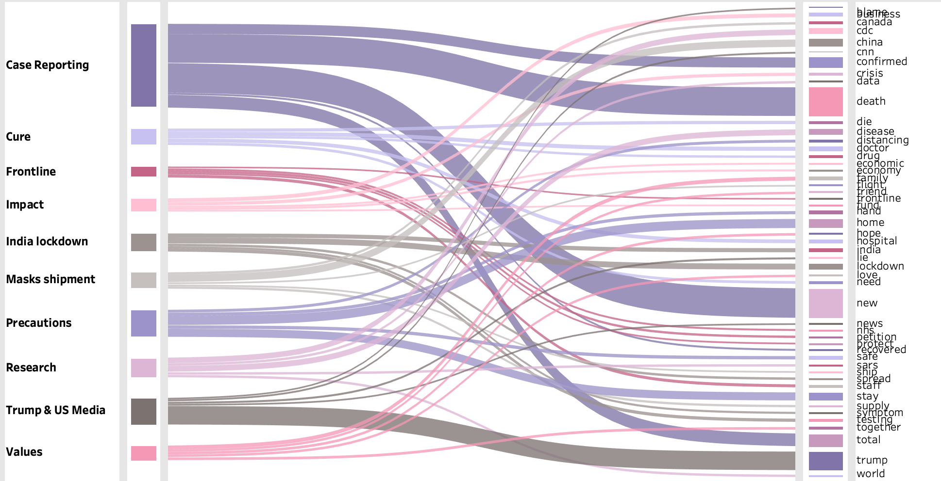
SOCIAL PULSE - TOPIC MODELING
Interpreted Topics
Top weighted words identified by LDA

Slide 9
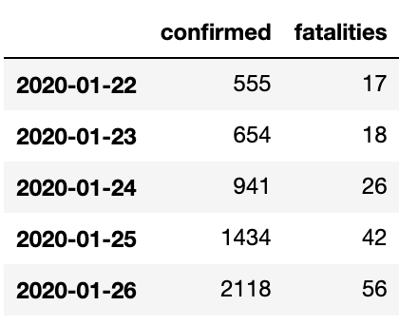
CASE FORECASTING - MODEL
Input
150 neurons
LSTM
“relu”
Dense
“relu”
75 neurons
Dense
Output = 2
neurons
Notes:
Split the whole dataset into training (90%) and validation (10%) sets.
Scaled confirmed and fatal case numbers with MinMax Scaler to normalize the numbers.
Generated batches of temporal data using TimeseriesGenerator with 5 steps i.e 5 data points to predict the 6th data point.
Instantiated a Sequential model with 150 neurons passed to LSTM layer, shrink the output to 75 neurons that is fed to a dense layer and another dense layer that further shrinks the final output to 2 (confirmed & fatal case).
Activation function used is relu, optimizer used is Adam and loss function is MSE.

Slide 10
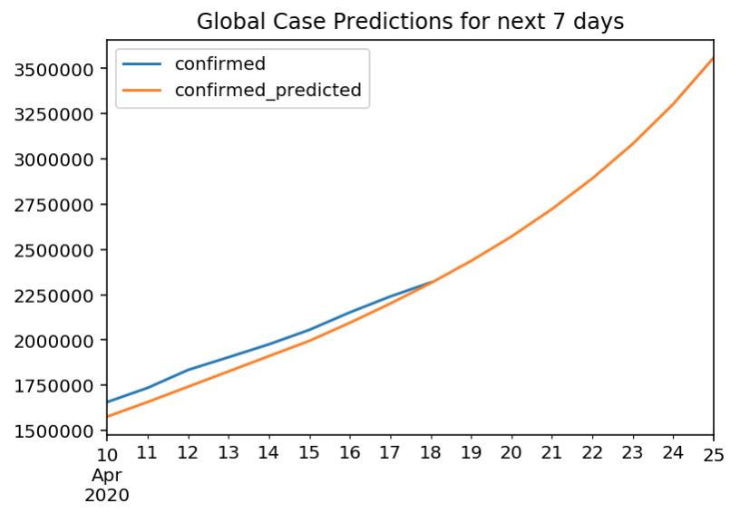
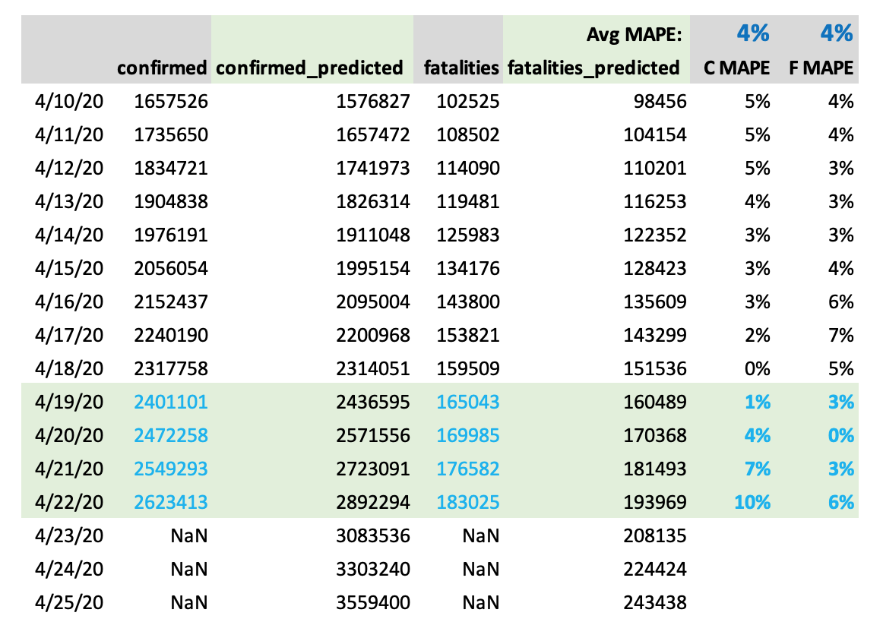

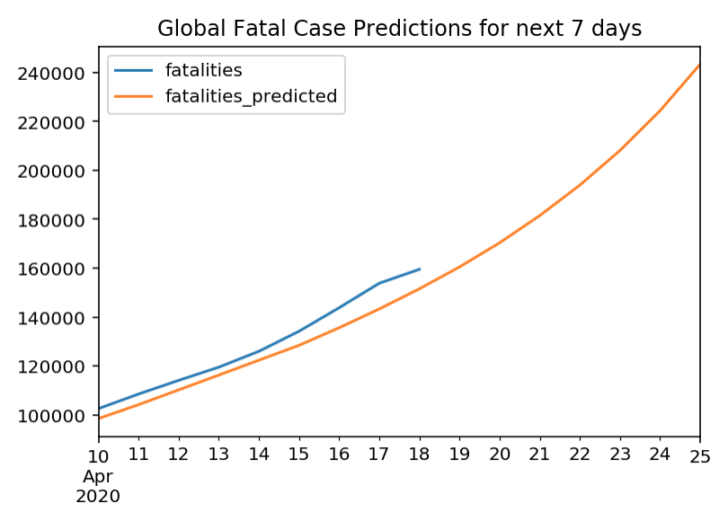

CASE FORECASTING - MODEL PERFORMANCE
Confirmed Cases:
Fatal Cases:

Slide 11
RECOMMENDATIONS & NEXT STEPS
Next Step
Topic Modeling
Enhancements
Use trigram option to enhance the model
Investigate why bigrams did not return as good a result as desired
Use grid search to tune hyperparameters
Next Step
Case Forecasting
Explore country level forecasting
Possibility to include more features such as weather / temperature conditions, population information etc. for increased accuracy
Use grid search to tune hyperparameters

Slide 12
DATASETS & REFERENCES
Base dataset: John Hopkins Centre of System Science and Engineering (Covid- case numbers and training data)
Demographic data for selected countries : The Lancet Digital Health
Economic Indicators : Yahoo Finance
Worldwide Government Responses: Oxford University Govt. Response Tracker
Tweets: Scraped using Twitter scraper API

